Slide 1
Chapter 10
Multirate Digital Signal Processing

Slide 2
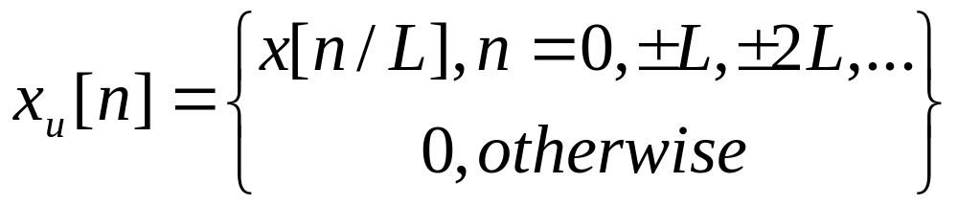
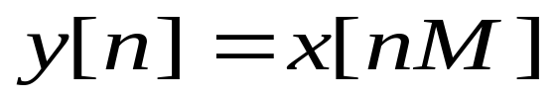
§10.1 Basic Sample Rate Alteration Devices
Time-Domain Characterization
(10.1)
(10.2)
x_{u}[n]=x[n/L]
x[n]
y[n]=x[nM]
x[n]
L
M

Slide 3
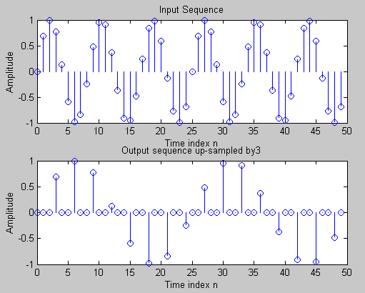
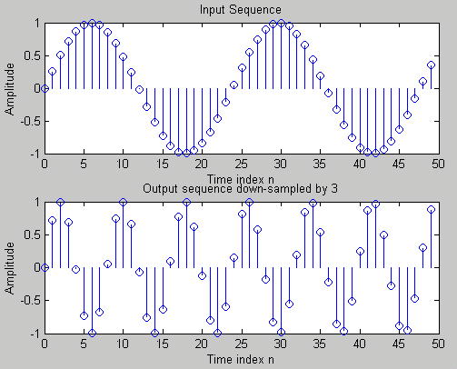

Slide 4
x[n]=x_{a}(nT)
y[n]=x_{a}(nMT)
M
Input sampling frequency
Output sampling frequency
F_{T}=1/T
F’_{T}=1/T’= F_{T} /M
⎧
x_{a}(nT/L), n=0,±L, ±2L,…
x[n]=x_{a}(nT)
x_{u}[n]
⎫
=
⎨
⎬
L
⎩
0, otherwise
⎭
Input sampling frequency
Output sampling frequency
F_{T}=1/T
F’_{T}=1/T’=LF_{T}

Slide 5
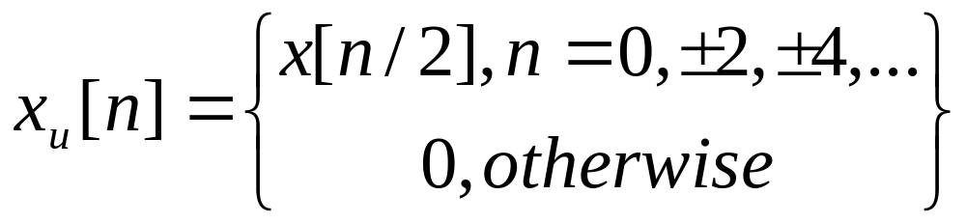
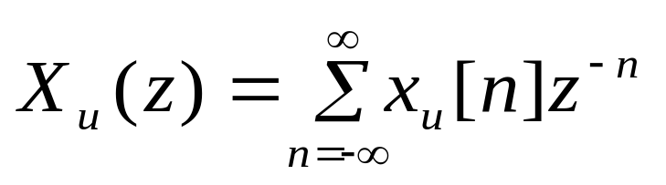
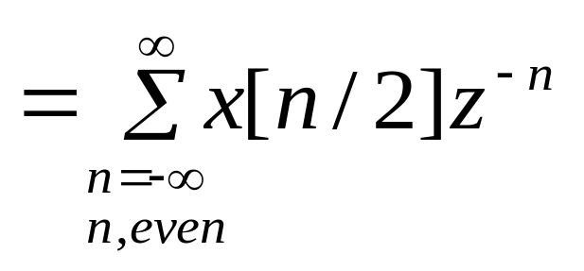
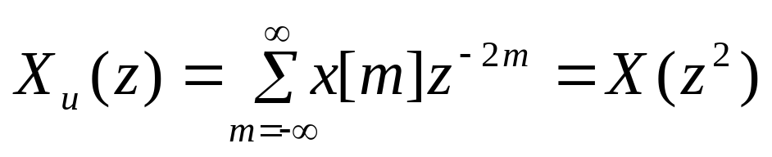
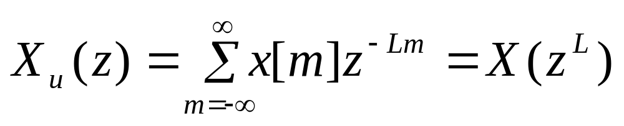
Frequency-Domain Characterization
For the factor-of-L up-sampler,

Slide 6
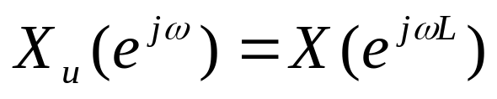
X
(
e
j
ω
)
ω
−
2
π
−
π
0
π
2
π
X
(
e
j
ω
)
u
L=2
ω
−
π
−
π
π
π
2
0
2
Effects of up-sampling in frequency domain

Slide 7
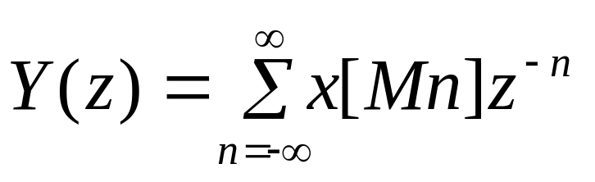
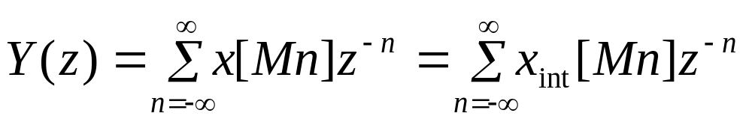
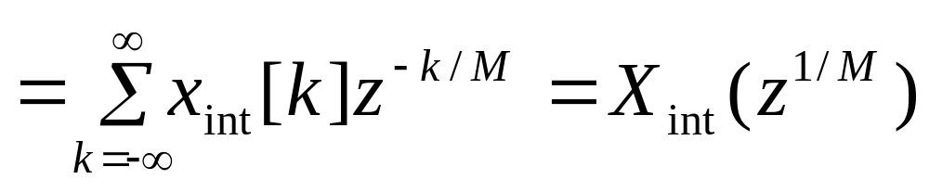
Considering down-sampler
Let
⎧
x[n], n=0, ±M, ±2M,…
⎫
x
[
n
]
=
⎨
⎬
int
0, otherwise
⎩
⎭
Then,

Slide 8
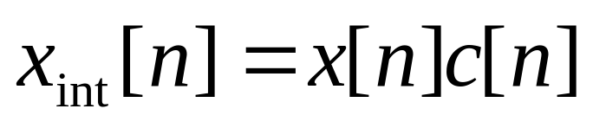
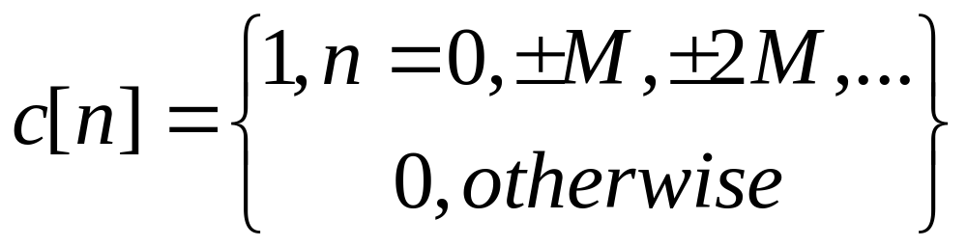
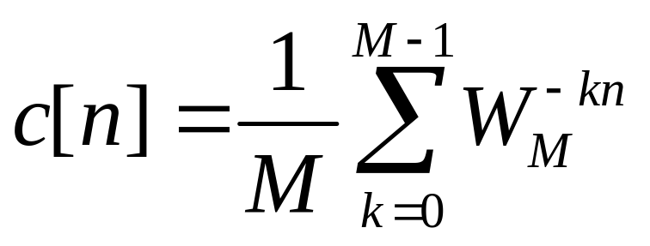
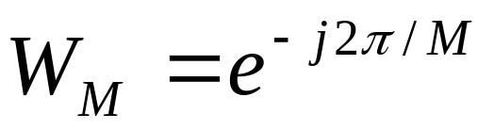
Now x_{int}[n] can be related to x[n]
through
A convenient representation is given by(Problem 10.4)
where

Slide 9
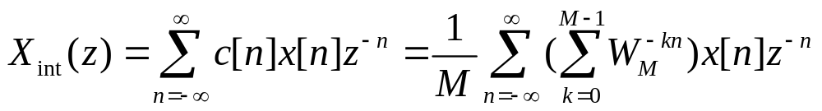
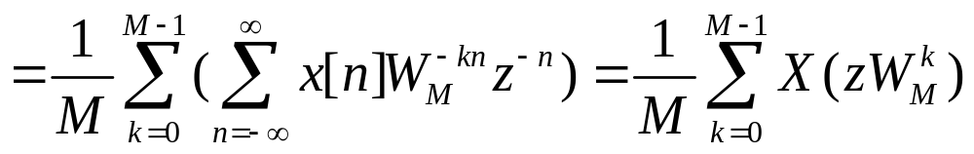
c[n]
1
n
-M
0
M
2M
Using Eq.(10.8) to Eq. (10.11), we get

Slide 10
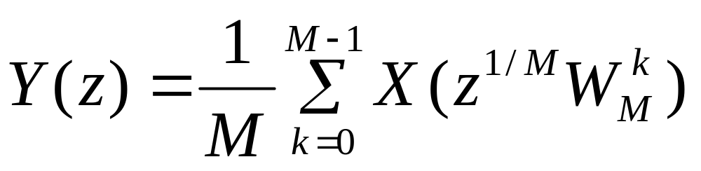
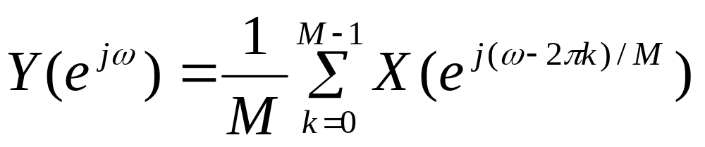
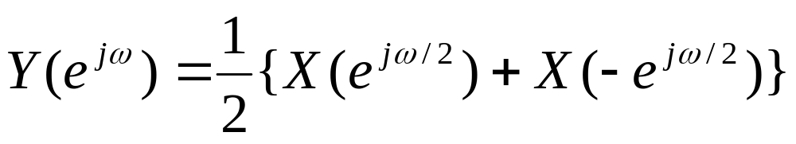
Example M=2,

Slide 11
X
(
e
j
ω
)
ω
−
2
π
−
π
0
π
2
π
2
Y
(
e
j
ω
)
M=2
ω
−
π
−
π
π
π
2
0
2
Effect of down-sampling in frequency
absence of aliasing

Slide 12
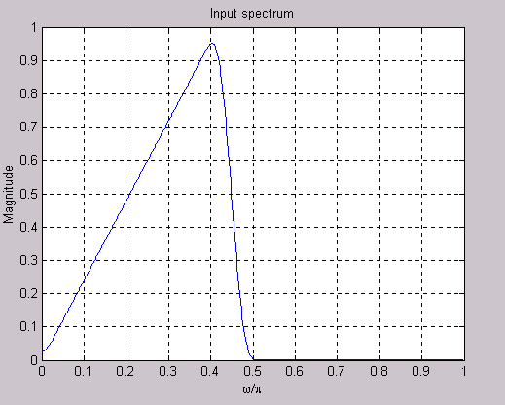
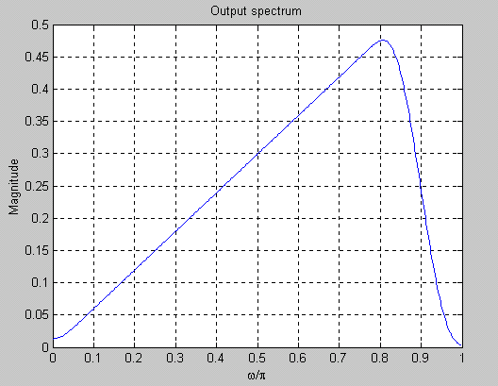
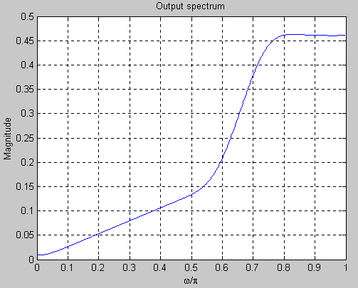
Effect of down-sampling in frequency
Input spectrum
output spectrum(M=2)
output spectrum(M=3)

Slide 13

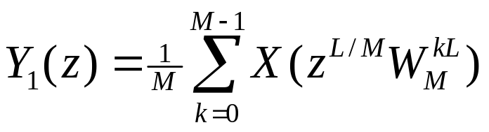
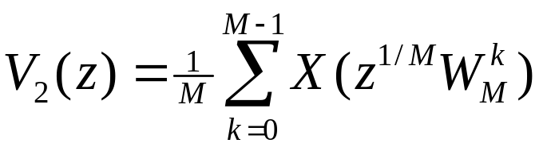
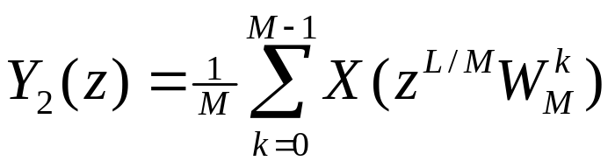
§10.2 Filters In Sampling Rate Alteration
Cascade Equivalences
Case 1
For the left-hand side figure,we have V₁=X(z^{L})
For the right-hand side figure,we have
Since L and M are relatively prime, W_{M}^{k} and W_{M}^{kL} take the same set of values for k=0,1,…, M-1.
Hence Y₁(z)=Y₂(z)

Slide 14
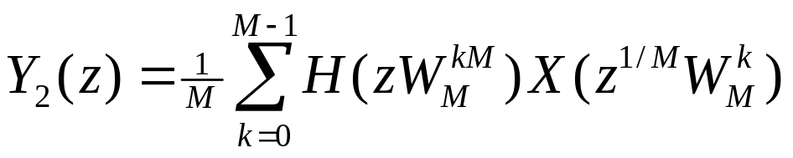
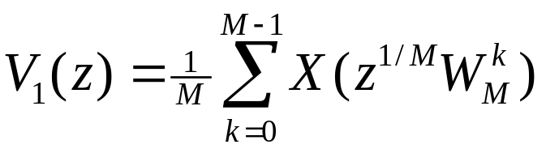
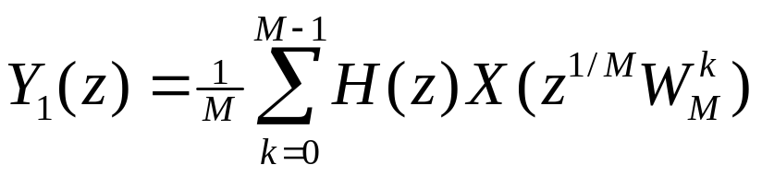
Case 2
v
[
n
]
v
[
n
]
x
[
n
]
1
y
[
n
]
x
[
n
]
2
1
y
[
n
]
M
H
(
z
)
H
(
z
M
)
2
≡
M
v
[
n
]
v
[
n
]
1
y
[
n
]
x
[
n
]
1
x
[
n
]
2
y
[
n
]
L
H
(
z
L
)
H
(
z
)
2
≡
L
(a) Cascade Equivalences
For the right-hand side figure,we have V₂=H(z^{M})X(z)
For the left-hand side figure,we have
Hence Y1(z)=Y2(z)

Slide 15
(b)
For the left-hand side figure, we have V₁=X(z^{L}), Y₁=H(z^{L})X(z^{L}).
For the right-hand side figure, we have V₂=H(z)X(z), Y₂=H(z^{L})X(z^{L}).
Hence, Y₁(z)=Y₂(z).
Filter Specifications
x
[
n
]
v
[
n
]
u
y
[
n
]
x
[
n
]
(
z
)
y[n]
x
[
n
]
L
H
H
(
z
)
M
Interpolator
Decimator

Slide 16
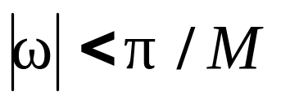
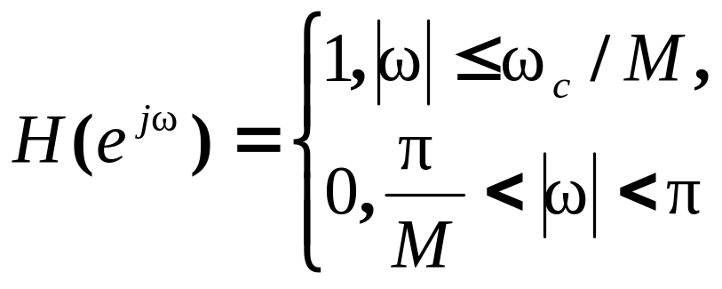
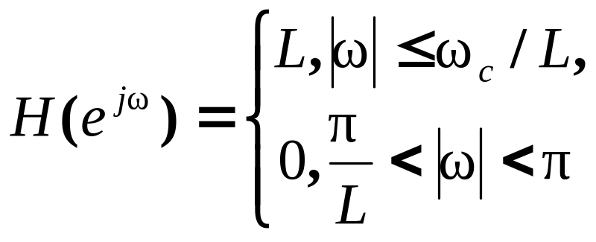
Decimator filter
interpolator filter

Slide 17
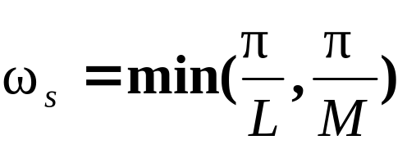
Filters for Fractional Sampling Rate alteration
H
(
z
)
M
H
(
z
)
d
L
u
H
(
z
)
H
(
z
)
M
L
u
d
H
(
z
)
L
M
General Schemes for increasing the sampling rate by L/M
H(z) is a LPF

Slide 18
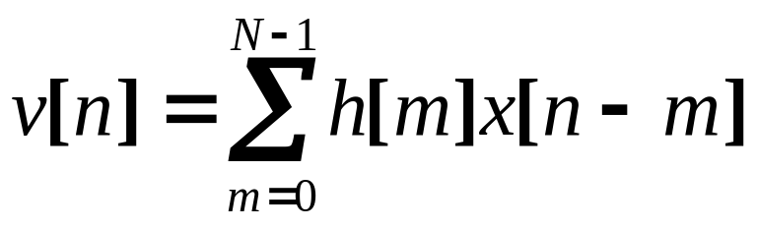
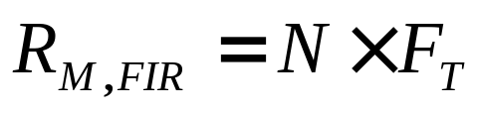
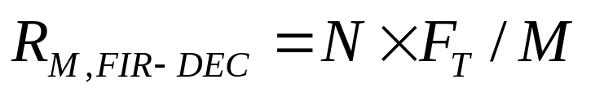
10.2.3 Computational Requirements
1. Decimator
v
[
n
]
If H(z) is a FIR(length-N)
x
[
n
]
y
[
n
]
H
(
z
)
M
The number of multiplications per second
keeps only every Mth sample of v[n],
computational saving factor -M

Slide 19
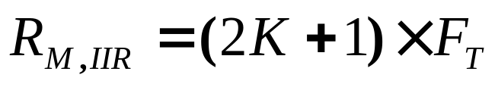
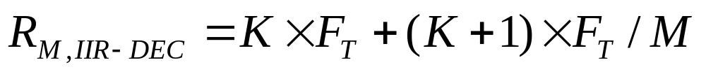
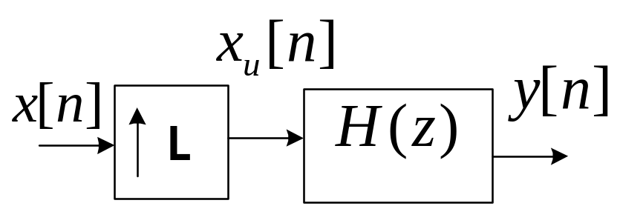
If H(z) is a IIR(order-K)
Less computational saving
2. Interpolator
It is similar to above.
If H(z) is a FIR, computational saving factor -L
If H(z) is a IIR, Less computational saving.

Slide 20
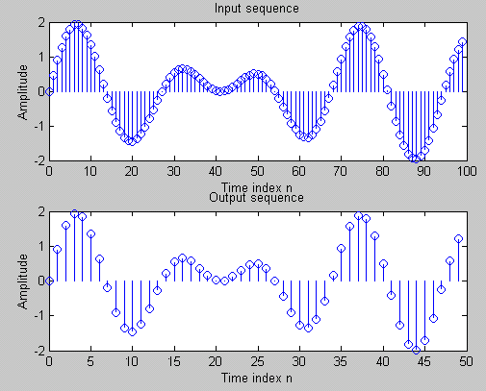
10.2.4 Matlab Simulation
y=decimate (x,M); M=2

Slide 21
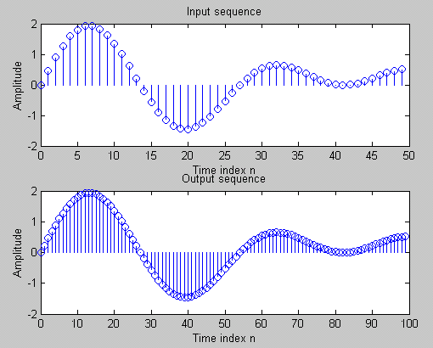
y=interp(x,L); L=2

Slide 22
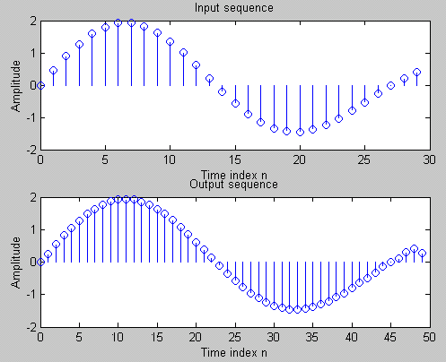
resample(x,L,M);)L=3,M=5

Slide 23
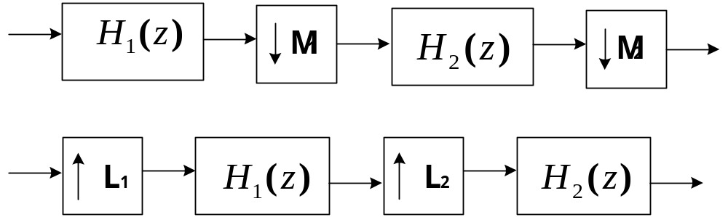
§10.3 Multistage Design of
Decimator and Interpolator
(a)
(b)
Two-stage implement
(a) Decimator (b) Interpolator
M=M₁×M ₂
L=L₁×L₂

Slide 24
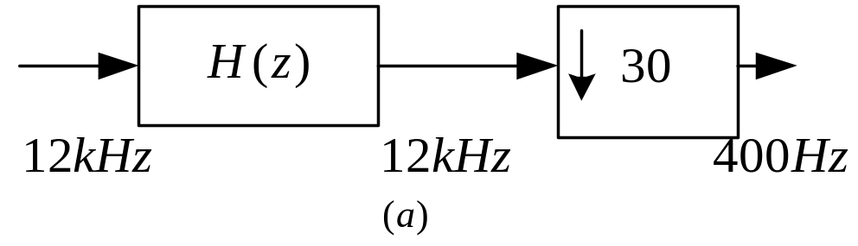
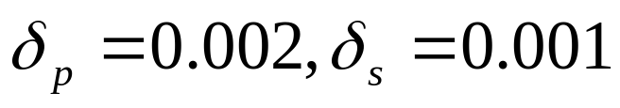
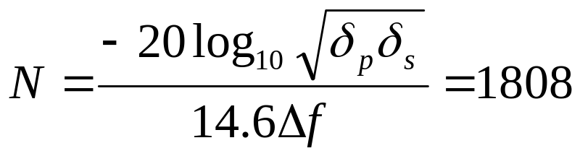
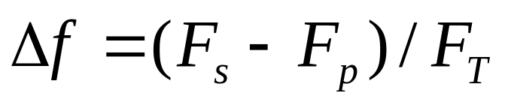
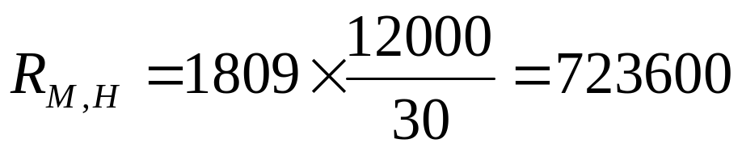
decimator implementation
(12kHz---400Hz)
single-stage
H
(
e
j
ω
)
π
ω
0
2
π
180
Hz
200
Hz
6
kHz
12
kHz
F
p
F
F
/
2
F
s
T
T
(
b
)

Slide 25

Two-stage
steps in two-stage implementation
G
(
e
j
ω
)
ω
0
π
2
π
2
.
7
kHz
3
kHz
6
kHz
9
kHz
12
kHz
15
F
15
F
F
/
2
F
−
15
F
F
p
s
T
T
s
T

Slide 26








|G(e^{j15ω})|
|F(e^{jω})|
...
0
2π
ω
180Hz
200Hz
F_{s}
600Hz
12kHz
F_{T}
F_{T}
G(z):
F(z):

Slide 27





steps in two-stage implementation
steps in two-stage implementation
Total complexity of FIR

Slide 28






Three-stage implementation
multi-stage implementation
S(z):
R(z):

Slide 29





Total complexity of FIR
The complexity of realization higher
than two-stages may not always lead to
a computationally efficient realization.

Slide 30



10.4 The Polyphase Decomposition
The Decomposition
Consider ZT
Rewrite
Then,

Slide 31




Slide 32
x
[
n
]
=
M
x
[
n
]
x
[
Mn
]
0
z
x
[
n
]
=
x
[
Mn
+
1
]
M
1
z
M
x
[
n
]
=
x
[
Mn
+
2
]
2
.
z
.
.
M
x
[
n
]
=
x
[
Mn
+
M
−
1
]
M
−
1
A structure interpretation of M-band polyphase decomposition of a sequence

Slide 33



10.4.2 FIR Filter structures Based on
the Polyphase Decomposition
v
[
n
]
y
[
n
]
x
[
n
]
H
(
z
)
M
H(z) is a FIR implemented with polyphase decompositon.
Type I
Type II

Slide 34
Type I,II are shown as following:
x
[
n
]
y
[
n
]
x
[
n
]
y
[
n
]
E
(
z
M
)
E
(
z
M
)
0
0
z
−
1
z
−
1
E
(
z
M
)
E
(
z
M
)
1
1
z
−
1
z
−
1
E
2
(
z
M
)
E
(
z
M
)
.
2
.
.
.
z
−
1
.
.
z
−
1
E
−
(
z
M
)
E
(
z
M
)
M
1
M
−
1
(a)
(b)
Realization of an FIR filter based on type I Polyphase decomposition

Slide 35
x
[
n
]
R
(
z
M
)
0
z
−
1
R
(
z
M
)
1
z
−
1
R
(
z
M
)
2
.
.
.
z
−
1
y
[
n
]
R
(
z
M
)
M
−
1
Realization of an FIR based on type II Polyphase decomposition

Slide 36


Based on Cascade Equivalences:
v
[
n
]
y
[
n
]
v
[
n
]
x
[
n
]
1
x
[
n
]
2
y
[
n
]
M
H
(
z
)
1
H
(
z
M
)
2
≡
M
More efficient

Slide 37
F
F
F
T
LF
F
T
T
LF
T
T
T
L
R
(
z
)
L
E
0
(
z
)
0
z
−
1
z
−
1
E
(
z
M
)
L
R
(
z
M
)
L
1
1
z
−
1
z
−
1
E
(
z
)
L
R
(
z
)
L
2
2
.
.
.
.
.
z
−
1
.
z
−
1
E
(
z
)
L
L
L
−
1
R
L
−
1
(
z
)
(a)
Type I
(b)
Type II
Computationally efficient interpolator

Slide 38

More efficient interpolator and decimator can be
realized by exploiting the symmetric of the
Filter coefficients of H(z) in the case of linear-phase.
Consider a decimator (M=3) with length-12
linear-phase FIR lowpass filter.
Which yields following subfilters:
E₀(z) and E₂(z) are symmetric, more efficient realization can be developed.

Slide 39

Generally, the filter of fraction-alterative rate(L/M)
could be realized by time-variant structure.

